Slide 1
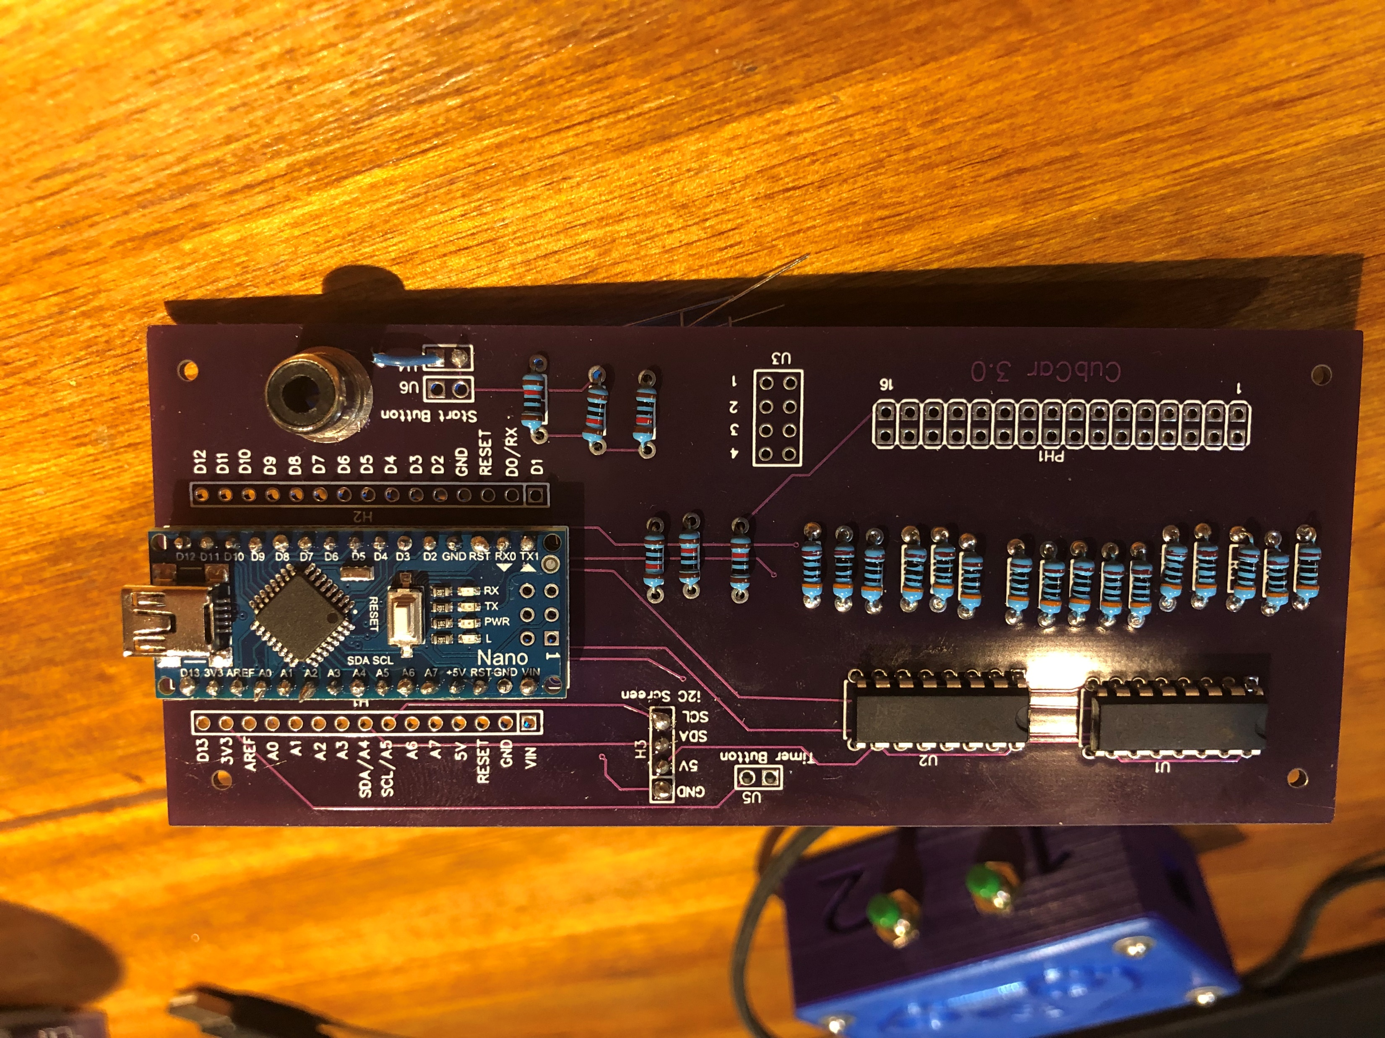
Timer Push Button
i2C 4x20 LCD Screen
Shift Registers
300 Ohm Resistors
Arduino Nano
LED Light Bank Connector
Light Detecting Resistors
10 K Resistors
Start Button / RCA

Slide 2
Notes:
Start switch not wired properly.
Put a jumper across U6
Wire one side of RCA connector to 3.3V and other side to U4 (Extra 3.3V connectors on common side of U3)

Slide 3
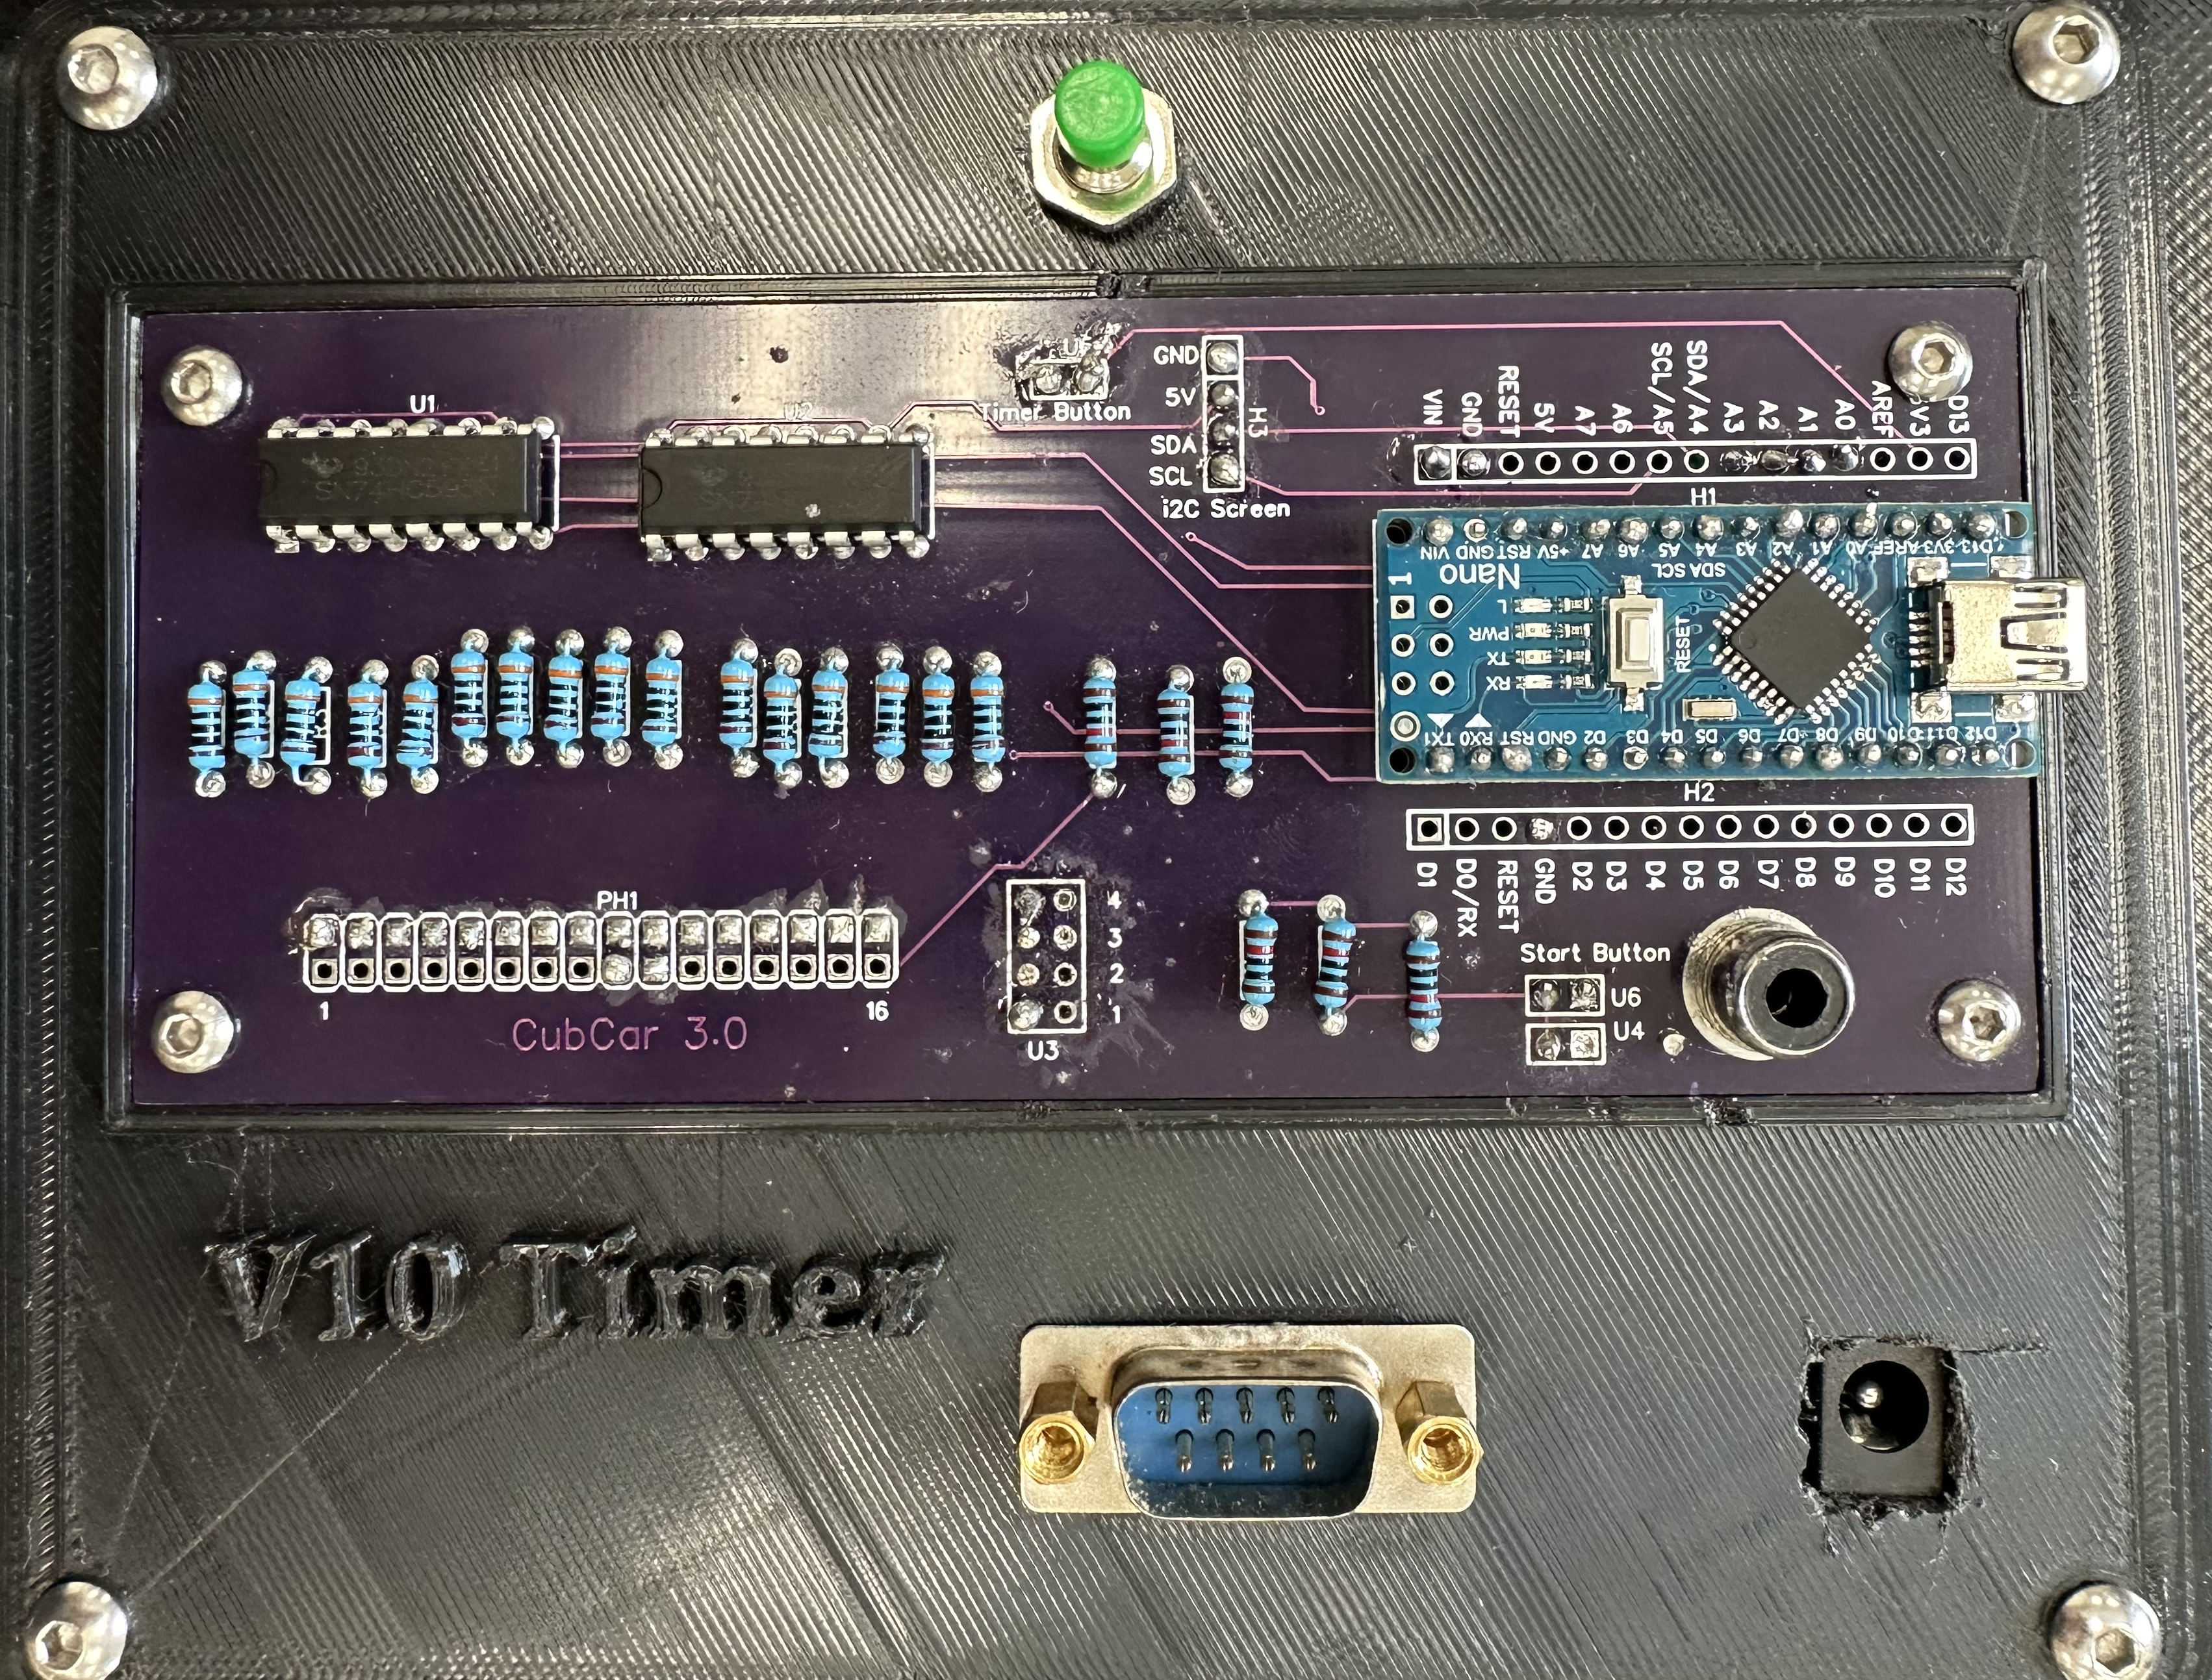
3. Nano Power
1. Remote Start Switch
2. Track Light Power
4. LDR Track Sensors

